Slide 1
CS2033a/b Lecture 3 Image Manipulation II “Channels” Vivi Tryphonopoulos

Slide 2
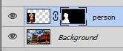
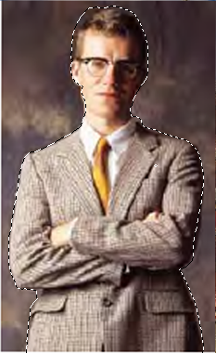
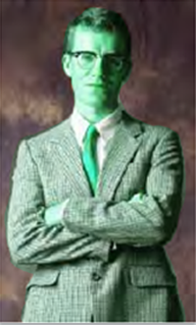

CHANNELS
So are you confused yet?
Masks:
Sophisticated selection tool
Layer Masks are non-destructive and can be reversed, reduced or modified at any subsequent point.
Accommodates complexity better
Quick Masks:
Temporary mask
Disappears as soon as deselect
But can save it as a alpha channel the alpha channels
So What Are Channels?

Slide 3
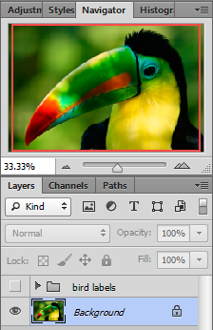
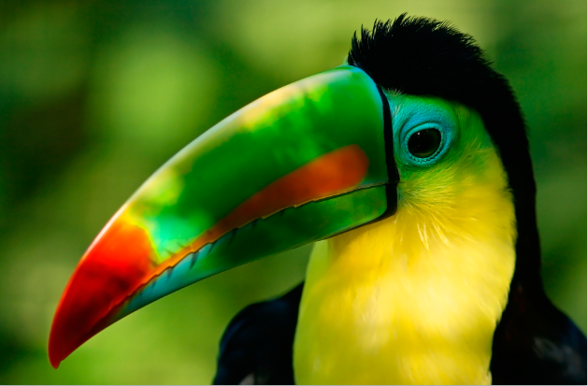
ALPHA CHANNELS
When you look at a color image in Photoshop, What do you see?
One big 24-bit composite collection of colored pixels
One layer for this image (background)

Slide 4
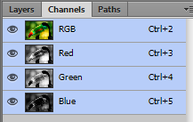
ALPHA CHANNELS
But what does Photoshop see? Click on Channels tab
A color image made up of three channels (RGB model)
All 3 channels (or bands) combined create the RGB Channel
Which are grayscale (to us)
Which shows it to us in color. (magic? Read on..)
A channel is NOT a layer

Slide 5
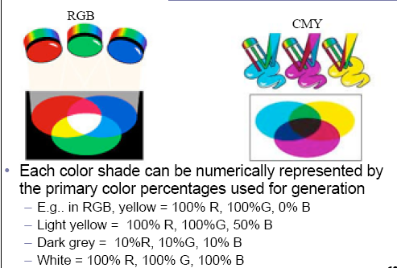
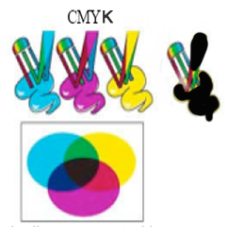
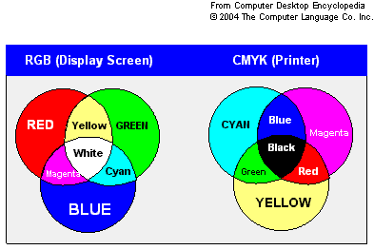
ALPHA CHANNELS
REMEMBER THE COLOR MODELS
Images for the Web
(onscreen viewing or inkjet printing
3 colors
Images for Print
(commercial)
4 colors
Photoshop stores all the color information that gets relayed to your monitor and printer
via Channels

Slide 6
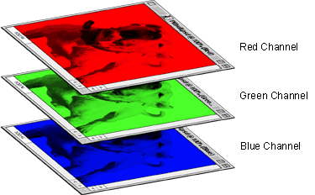
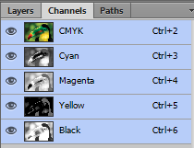
CHANNELS
The Channel panel upfront!
Individual bands of 8-bit grayscale images
If RGB - 3 bands (3 x 8 bit = 24 bit for each pixel)
If CMYK - 4 bands (4 x 8 bit = 32 bit for each pixel)
A color image is the sum of several grayscale channels
A bit of Terminology
Composite channel Always at the top of the panel – RGB or CMYK (shows all the channels together)
Color channels: individual band but you see it in graytones
Each band is called a channel

Slide 7
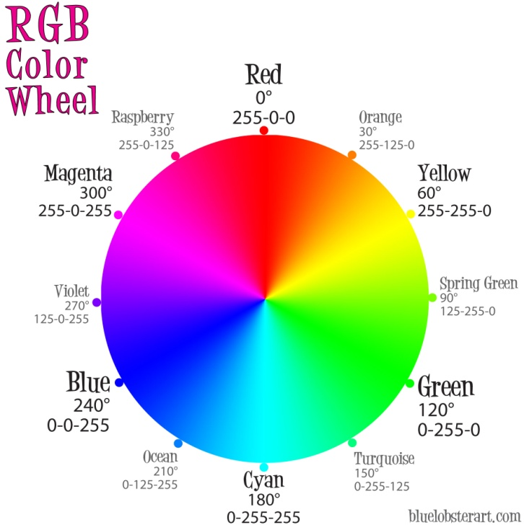
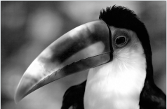
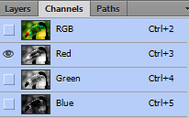
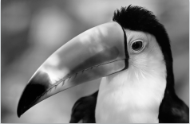
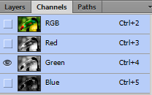
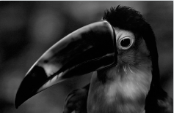
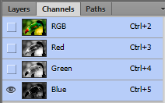
CHANNELS AND MASKING PANELS
So what are channels? Store image information
Photoshop is showing you the grayscale versions of each of these channels
Why in greytones?
Easier to evaluate the brightness values or luminance levels inside the channel.
So what do bright spots represent in each channel?

Slide 8
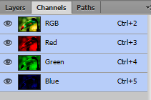
CHANNELS AND MASKING PANELS
Default Display: Photoshop displays channels in grayscale.
Optional:
To display color in channel: Edit > Preferences> Interface >Show Channels in Color (checkbox)

Slide 9
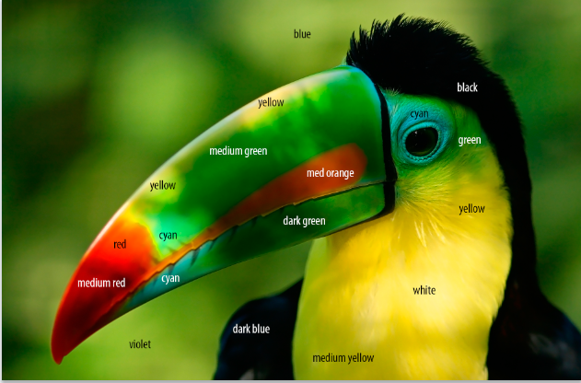

CHANNELS AND MASKING PANELS
Yellow – red + green
Cyan – green + blue
Magenta – red + blue

Slide 10
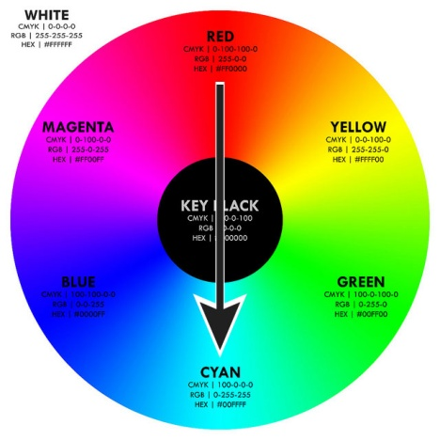
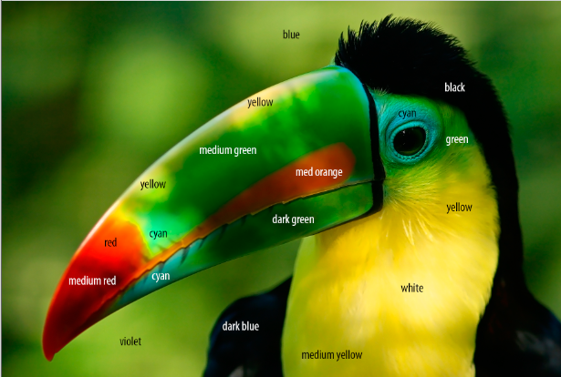
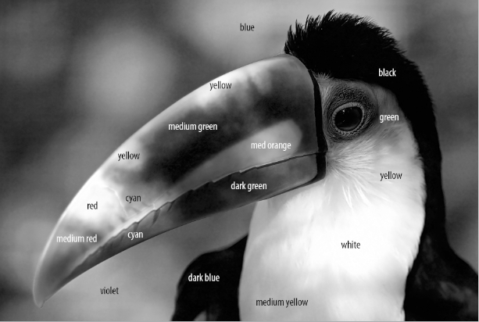
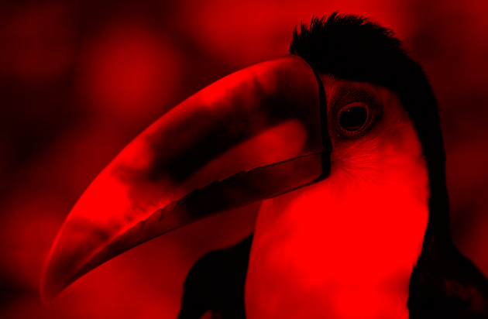
CHANNELS
So what do bright spots represent in each channel?
Red channel
The red channel (in grayscale):
Contributions of red for final color showed in composite
White spots – color at its full strength (some contribution of red to make yellow)
Black – color at its weakest (no red)
Gray tones – contribution of red tones (red+ green = yellow)
Reverse for CMYK model

Slide 11
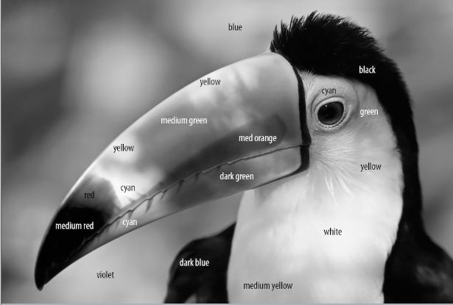
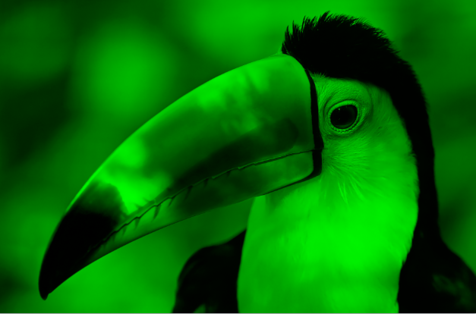
CHANNELS
So what do bright spots represent in each channel?
Green channel
The green channel (in grayscale):
Contributions of green for final color showed in composite
White spots – color at its full strength (some contribution of green to make yellow)
Black – color at its weakest (no green)
Gray tones – contribution of green tones (blue+green=cyan)

Slide 12
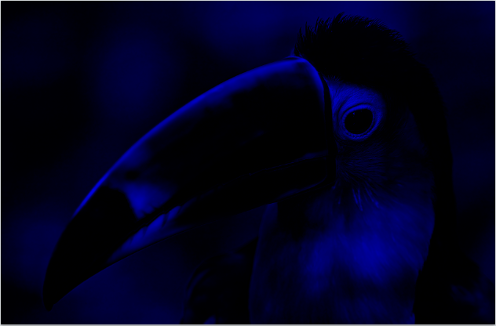
CHANNELS
So what do bright spots represent in each channel?
Blue channel
The blue channel (in grayscale):
Contributions of blue for final color showed in composite
White spots – color at its full strength (some contribution of blue to make cyan)
Black – color at its weakest (no blue)
Gray tones – contribution of green tones (blue+green=cyan)

Slide 13
CHANNELS
Colors mixed together gives the final image
Grayscale tones show :
Luminance easier
Contribution of each color
Summary Channels:
Channels are not layers - they cannot be printed.
Store color information about image
Use them to make selections which help with manipulation
Offer greater control and sensitivity in performing various functions like blending, filtering and retouching
Channels are automatically created when you open or create a image

